Slide 1
Cricket Management System
Group Members
Haram Zainab ( BSE – 23F – 137 )
Syeda Ayesha ( BDA - 24S - 007 )
Syeda Sanawar Kamran ( BSE – 23F – 102 )

Slide 2
Cricket Management System
INTRODUCTION
ER MODEL
CONTRIBUTIONS
QUERIES AND THEIR OUTPUT

Slide 3
Introduction to the Cricket Management System
A Cricket Management System Database is designed to help manage and organize the various details involved in running cricket tournaments, teams, players, matches, and statistics. This system makes it easier for cricket boards, clubs, and organizations to keep accurate records and manage their activities efficiently.
Objectives: The main goals of the Cricket Management System Database are:
Organization: To keep data about players, teams, matches, and tournaments well-organized.
Efficiency: To make managing cricket activities quicker and easier.
Accessibility: To ensure that important information is easy to find and up-to-date.
Decision Support: To help make better decisions through detailed reports and statistics.
Scalability: To handle more data as the organization grows.

Slide 4
Contribution of Group Members
Haram Zainab
Create Tables
Data insert in all tables
Making ER Model
Write 20 Queries
Syeda Ayesha
Helping in to Make ER Model
Write 15 Queries
Syeda Sanawar Kamran
Helping in to Make tables
Write 15 Queries

Slide 5
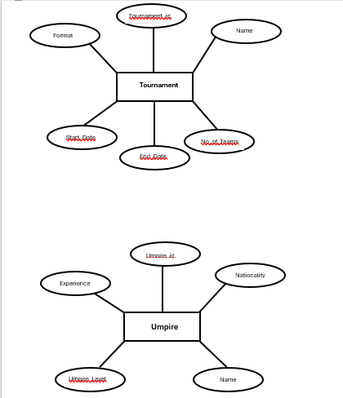
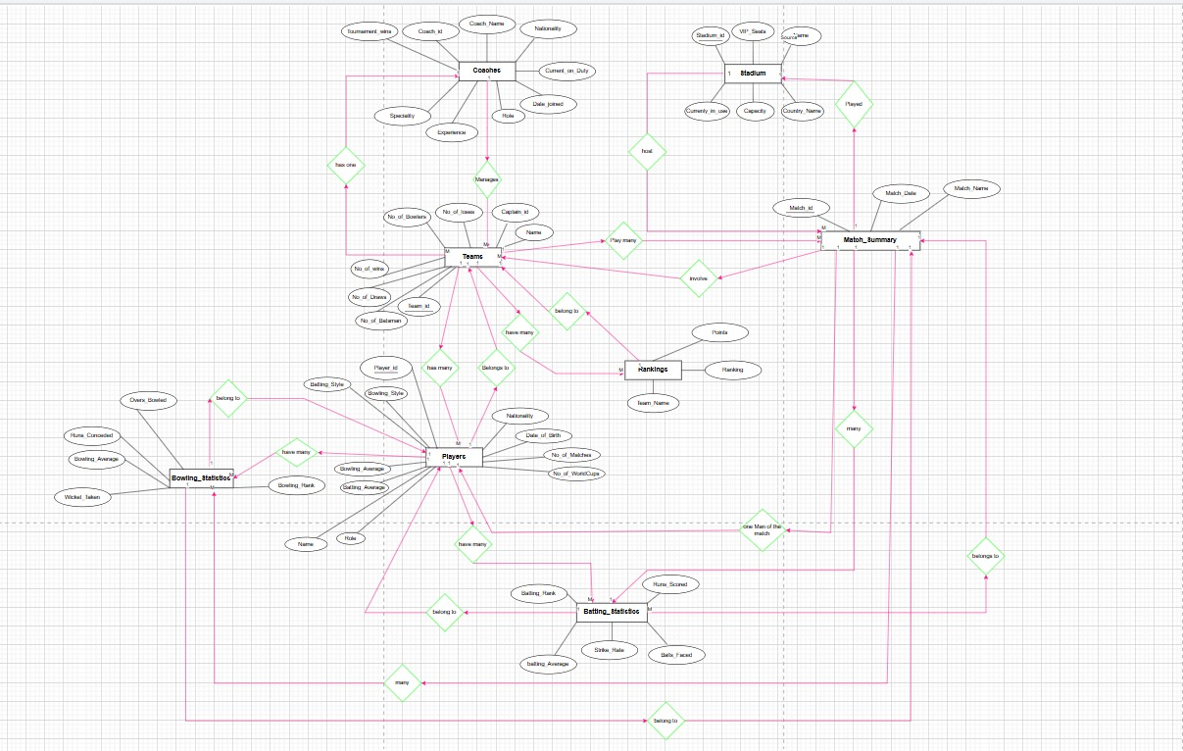
ER Model

Slide 6
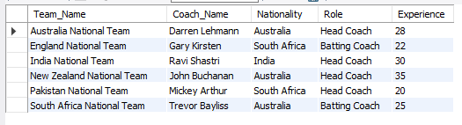


Queries of Table # 01 ( Coaches Table )

Slide 7
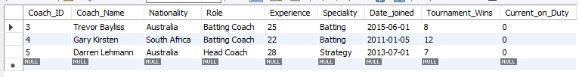


Queries of Table # 01 ( Coaches Table )

Slide 8
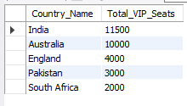
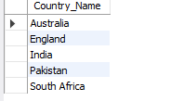

Queries of Table # 02 ( Stadiums)

Slide 9
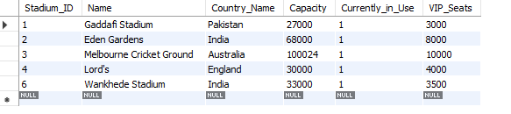
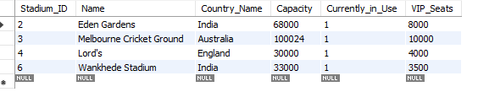
Queries of Table # 02 ( Stadiums)

Slide 10
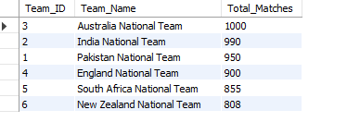
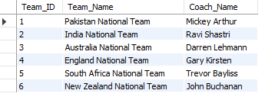
Queries of Table # 03 ( Teams )

Slide 11
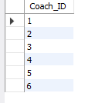
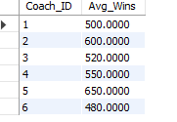
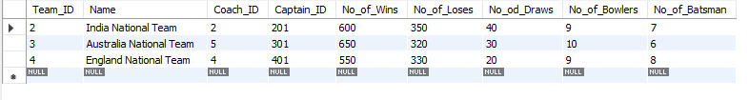
Queries of Table # 03 ( Teams )

Slide 12
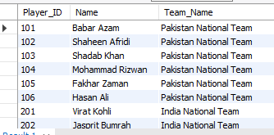
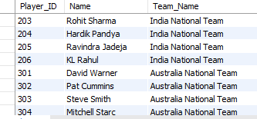
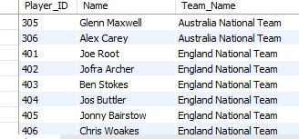
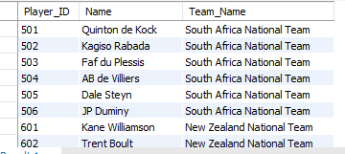
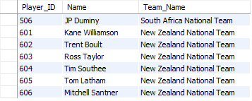
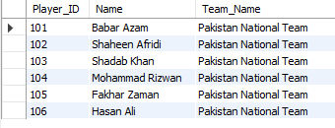
Queries of Table # 04 ( Players )

Slide 13
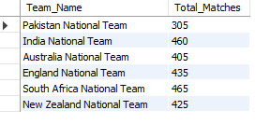
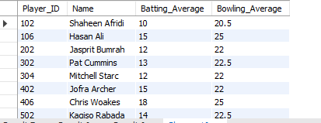
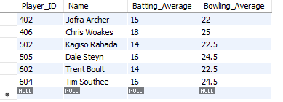
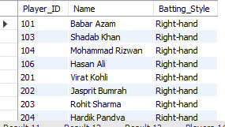
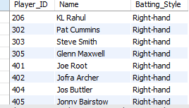
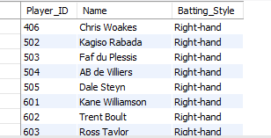
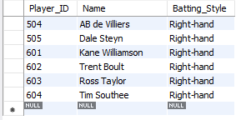
Queries of Table # 04 ( Players )

Slide 14
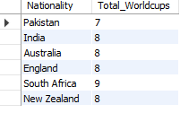
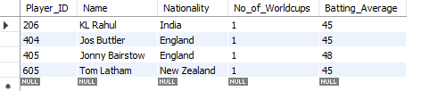
Queries of Table # 04 ( Players )

Slide 15
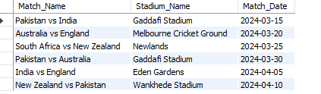
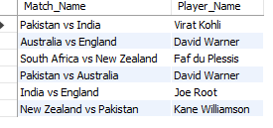
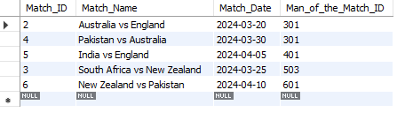
Queries of Table # 05 ( Match_summary )

Slide 16
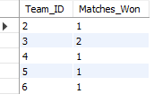

Queries of Table # 05 ( Match _summary )

Slide 17
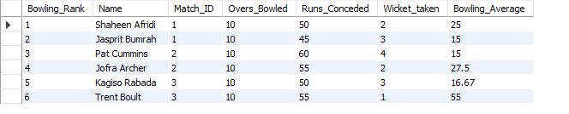
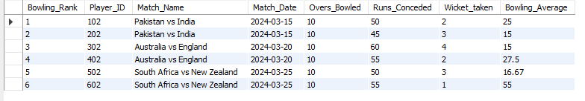
Queries of Table # 06 ( Bowling_ statistics )

Slide 18

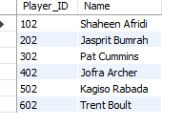
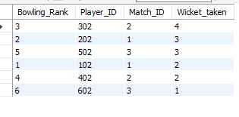
Queries of Table # 06 ( Bowling _statistics )

Slide 19
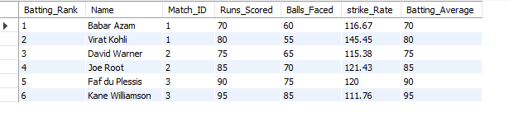
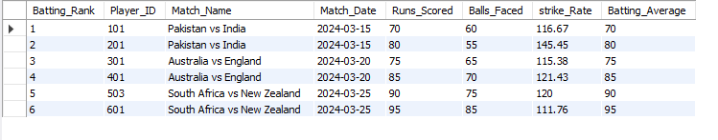
Queries of Table # 07 ( Batting_ statistics )

Slide 20
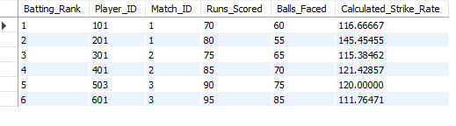
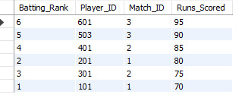
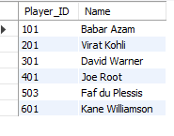
Queries of Table # 07 ( Batting_ statistics )

Slide 21
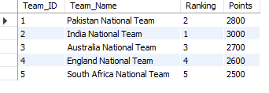

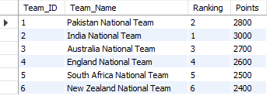
Queries of Table # 08 (Rankings )

Slide 22
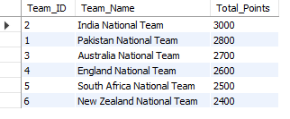
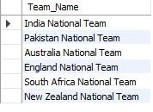
Queries of Table # 08 (Rankings )

Slide 23
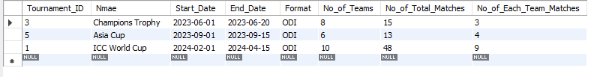


Queries of Table # 09 (Tournaments )

Slide 24
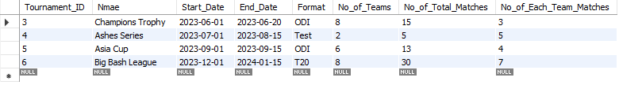
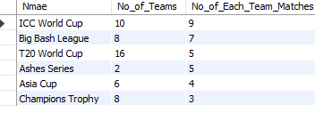
Queries of Table # 09 (Tournaments )

Slide 25

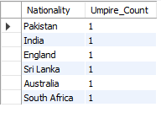
Queries of Table # 10 (Umpire )

Slide 26
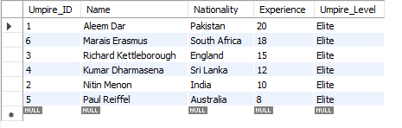


Queries of Table # 10 (Umpires )

Slide 27
Thank you

